Slide 1


Technology Partner
Bank of Baroda Hackathon - 2024
Your Team Name: Fire Exit
Your team bio :
We are a team of highly motivated developers, aiming on creating projects that would benefit the society as a whole.
Date : 30/06/2024

Slide 2

Problem Statement?
Challenge: Automate the Slow and Tedious Task of Cheque Processing!
The Problem: Banks are flooded with cheques, leading to lengthy processing and verification times. This creates a bottleneck for everyone:
Citizens: Face long wait times for their cheques to clear.
Banks: Struggle with inefficient manual processing, requiring significant resources.
Government: Encounters potential delays in overall financial transactions.
Signature Verification
Fraud Detection

Slide 3
User Segment & Pain Points
This AI-powered solution tackles the challenges of manual cheque processing, benefiting banks, citizens, and the government. Manual processing is slow, prone to errors (bounced cheques), and vulnerable to fraud (hacked accounts, forged signatures).
Our solution addresses these issues with superior accuracy and efficiency. It utilizes technologies like Optical Character Recognition (OCR), image acquisition, and Magnetic Ink Character Recognition (MICR) to:
Extract data flawlessly: Signatures, amounts, and other details are captured with exceptional precision.
Reduce processing time: Cheques are cleared significantly faster compared to manual methods.
Minimize errors: The risk of bounced cheques or fraudulent activity is dramatically reduced.
Maintain data integrity: Unnecessary white spaces are eliminated without compromising image quality.
Reduces Human Labour
Faster Transaction
Secure Transaction
Fraudulent Cheque Detection

Slide 4
Pre-Requisite
In this model, we use Some technologies-
Artificial Intelligence
Machine learning
Optical Character Recognition
CNN
Feature Extraction
Python
HTML, CSS, JS
Magnetic Ink character recognition
Flask/Django/React

Slide 5
Azure tools or resources
Infrastructure as a service
Azure files
Windows, Linux
Virtual Network
Platform as services
Visual code
Cloud Services
SQL Database
Other Resources
Machine learning
Magnetic ink character recognition
Object Character Recognition
NLP, Image Recognition, Convolutional Neutral Network

Slide 6
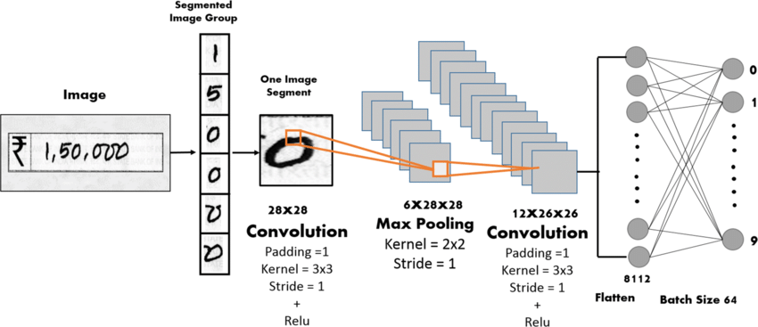
Any Supporting Functional Documents
1. Image Acquisition:
The process begins by scanning the cheque to capture a digital image.
2. Signature Verification:
Next, the system focuses on the signature for verification:
Signature Area Identification: The signature area is precisely located and cropped from the full cheque image.
Feature Extraction: Key characteristics of the signature are extracted for comparison.
Signature Recognition: The extracted features are compared to authorized signatures on file.
Verification Result: A clear message is displayed indicating whether the signature is verified or not.

Slide 7
Key Differentiators & Adoption Plan
Our solution goes beyond competitors, offering a comprehensive cheque processing experience. Here's what sets us apart:
End-to-End Automation: We handle everything from cheque image scanning to secure fund transfer, mimicking the functionality of SQL databases.
Enhanced Security: Data extracted from cheques is stored securely in SQL databases, ensuring privacy and protection.
Advanced Fraud Detection: Unlike most programs, ours goes beyond signature verification. We utilize a model to identify inconsistencies in handwriting, potentially indicating fraud attempts.
Flexible Deployment: Choose from popular frameworks like Flask, Django, or React for seamless user experience.

Slide 8
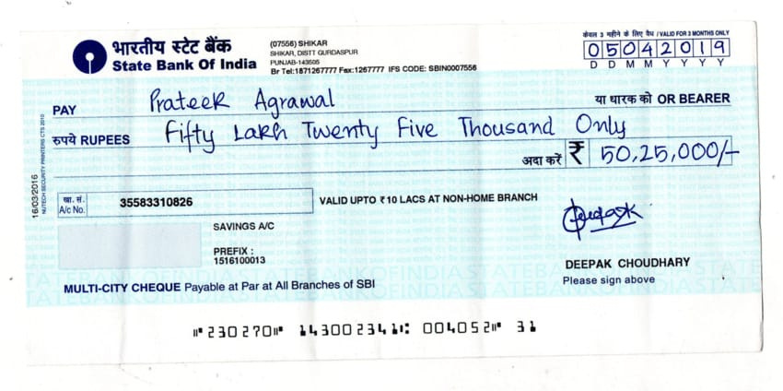
GitHub Repository Link & supporting diagrams, screenshots
GitHub Link: https://github.com/SakshiDargu/BOB-Hackathon-2024
Image Processing and Data Extraction Techniques
Field Extraction using OCR
Modified CNN
Feature Extraction and PCA
Verification
If (Validation==True)
Success Transaction
Failed Transaction

Slide 9
Thank You
Khushi Aggrawal
Sakshi Dargu

